Slide 1
Disposal of University Records
LRC Network 23rd March 2011

Slide 2
What is a record?
A public record is:
‘Any record made or received by a public officer in the course of their duties’
Public Records Act 1973
A university record is:
'any record created or received by staff of the University in the course of conducting their University duties’
UOM Records Management Policy (draft)

Slide 3
The records lifecycle
Record
Creation
Capture
Storage
Disposal

Slide 4
What is disposal?
Four different types of disposal are possible within UOM:
Destruction under Normal Administrative Practice
Destruction under a Retention and Disposal Authority
Transfer to intermediate storage
Transfer to the Archives

Slide 5
Where do you start?
The best place to start is with categorising your records.
This will then allow you to determine what has to happen to each different type of record.
The key document to help you know how long a record has to be kept is the Retention and Disposal Authority.

Slide 6
UoM Retention and Disposal Authority
RDA gives minimum time periods for the retention of different types of records.
Records can be retained longer, but need to consider privacy and FOI implications
Available in pdf or as a searchable database at :
http://www.unimelb.edu.au/records/RDA/

Slide 7
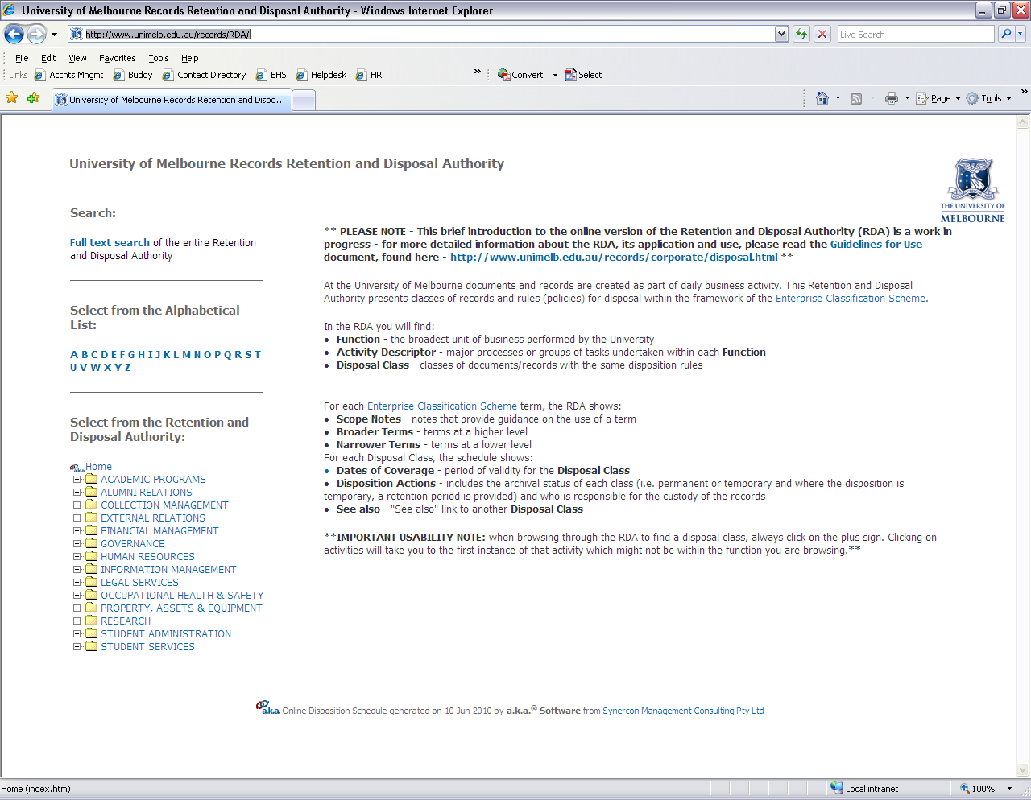

Slide 9
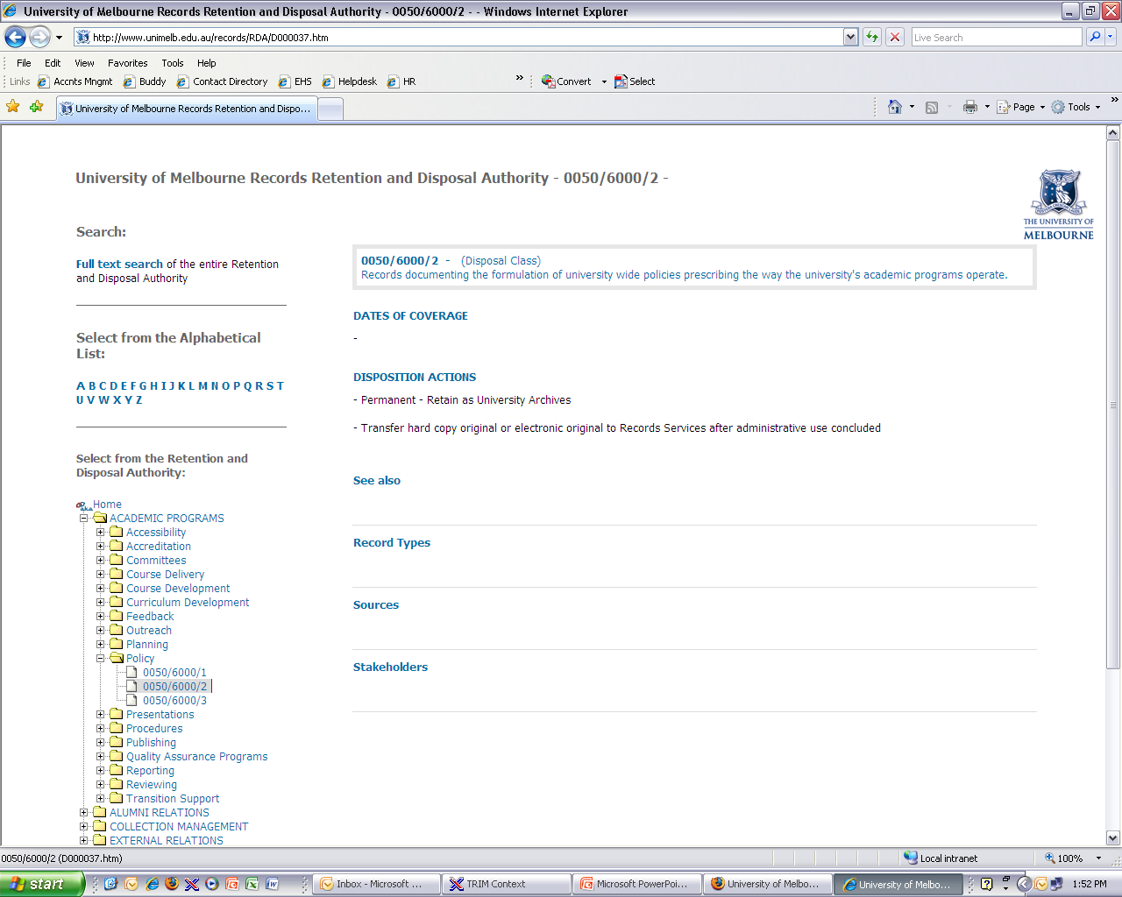

Slide 10
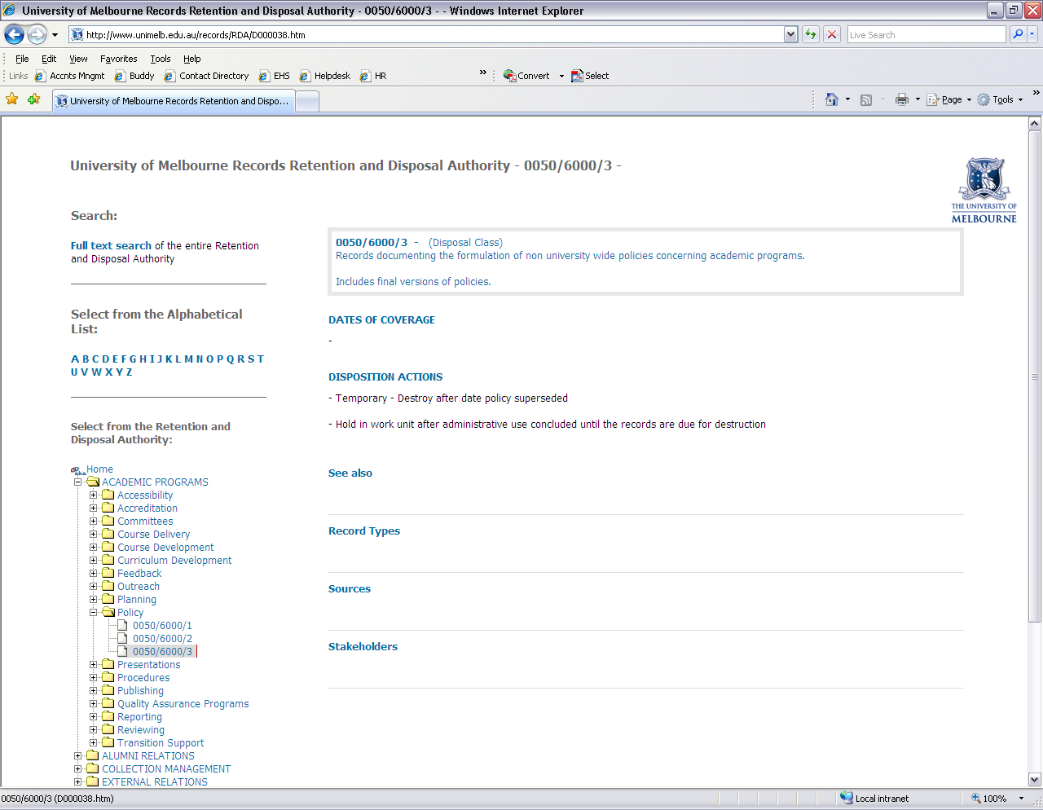

Slide 11
NAP
NAP allows for routine destruction of particular types of records without using a disposal authority
These records are:
working papers consisting of rough notes and calculations used solely to assist in the preparation of other records such as correspondence, reports and statistical tabulations
drafts not intended for retention as part of the office’s records, the content of which has been reproduced and incorporated in the public office's record keeping system
extra copies of documents and published material preserved solely for reference
Unsolicited advertising or reference material
‘For information’ copies where the record is maintained by another area

Slide 12
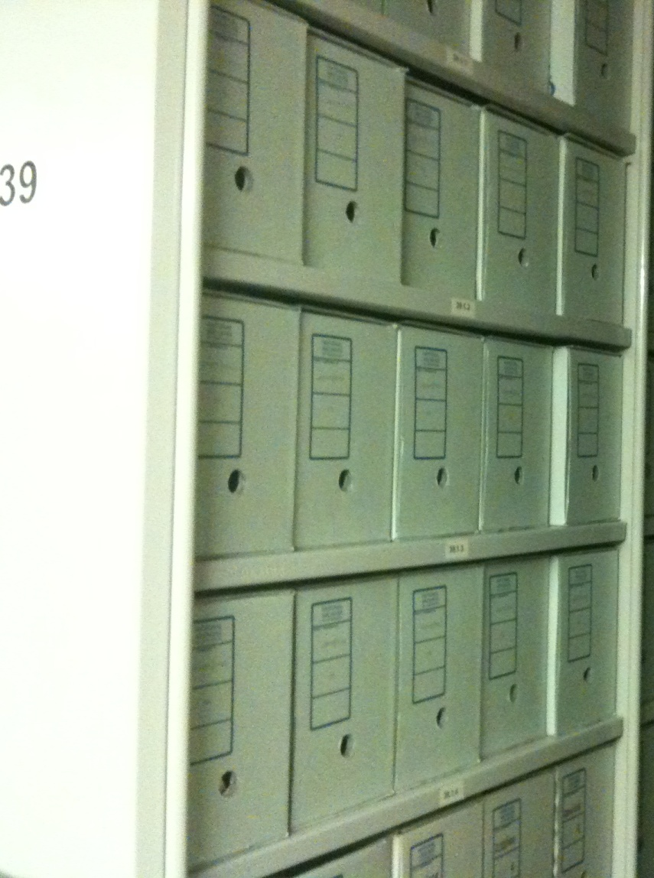
Transfer
Permanent records are first transferred to intermediate storage managed by Records Services
Currently records are held under the Raymond Priestley Building and Wilson Hall.
Records must be prepared for transfer by boxing and listing. Records Services will help you do this

Slide 13
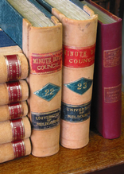
Transfer
25 years after the transfer of records to Records Services, permanent records will be transferred to the University Archives.
The Archives won’t take material directly from business areas – you need to contact Records Services first.
Notes:
Possibly discuss personal papers

Slide 14
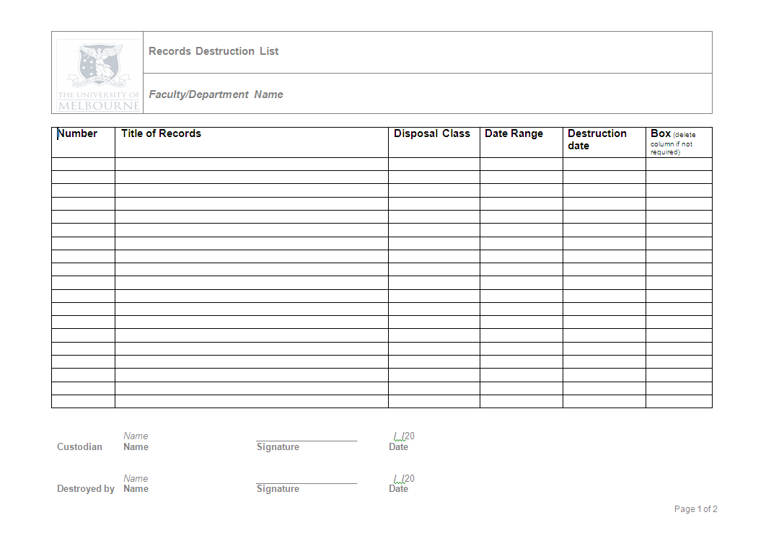
Records Destruction
Destruction of time expired records needs to be recorded.
The Records Destruction List is on the intranet at:
http://www.unimelb.edu.au/records/forms.html
Once you have completed the list, it should be forwarded to Records Services

Slide 15
Secure Destruction
Destruction of NAP or time expired records should be secure.
Records destruction bins are provided through Property and Campus Services
Details on how to order bins can be found at:
http://www.pcs.unimelb.edu.au/services/disposal/confidential_waste
Notes:
Discuss destruction certificates

Slide 16
Disposal Plans and Programs
Disposal programs allow for the systematic assessment and disposal of records.
They consist of regular cycles of review sentencing and transfer of records.

Slide 17
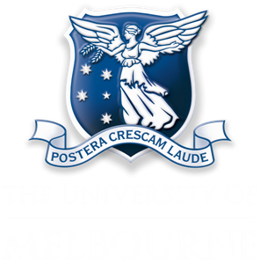
© Copyright The University of Melbourne 2009

