Slide 1
University of Melbourne Records Retention and Disposal Authority (RDA)
Lucinda Davies
Notes:
Most of what I am talking about is covered in the guidelines for use, found at the front of the RDA.

Slide 2
Introduction
The University of Melbourne Records Retention and Disposal Authority (RDA) is
“…the University document that sets out requirements for retention and disposal of all types of records, in line with legislative requirements and University business needs…”
(Records Management Policy MPF1106)
Records Services is responsible for developing the RDA
The University Archivist, Legal Services and the Director, Internal Audit are also consulted
The final document is approved by the University Secretary
(Records Management Policy MPF 1106, Records Retention and Disposal Procedure MPF1109)
Notes:
The University of Melbourne Records Retention and Disposal Authority (RDA) is
“…the University document that sets out requirements for retention and disposal of all types of records, in line with legislative requirements and University business needs…”
(Records Management Policy MPF1106)
Records Services is responsible for developing the RDA
The University Archivist, Legal Services and the Director, Internal Audit are also consulted
The final document is approved by the University Secretary
(Records Management Policy MPF 1106, Records Retention and Disposal Procedure MPF1109)

Slide 3
Purpose of the RDA
Provides a legal mechanism for the retention and disposal of university records in accordance with the Public Records Act 1973
Identifies records to be kept permanently
Prevents premature destruction of records
Specifies the minimum (and in some cases maximum) retention period
Authorises destruction of records deemed temporary
Mandates prompt destruction of records as per the Information Privacy Act 2000
Notes:
The purpose of the RDA is to provide a legal mechanism for the retention & disposal of university records in accordance with legislative instruments and regulations issued under the Public Records Act 1973.
The Authority also -
identifies records which are required to be preserved permanently as part of the University’s archival heritage;
prevents the premature destruction of records which need to be retained for a specified period to satisfy legal, financial and other requirements of public administration;
specifies the minimum, and in some cases maximum, periods for which records are required to be retained;
authorises the destruction of those records not required permanently; and
mandates the prompt destruction of records as required under the Information Privacy Act 2000 and other instruments

Slide 4
What records does the RDA apply to?
University Records
“…any record comprised of recorded information, in any format, created or received by staff of the University in the course of conducting their University duties…”
(Records Management Policy MPF1106)
Notes:
What records does the RDA apply to?
The RDA applies to University records only. A University record is defined as “…any record comprised of recorded information, in any format, created or received by staff of the University in the course of conducting their University duties…”
(Records Management Policy MPF1106)

Slide 5
What about records of semi-autonomous bodies or subsidiary companies?
Records of semi-autonomous bodies records – RDA does apply
Records of University subsidiary companies are not University records – RDA does not apply
But any records created by or provided by the University in connections with its dealings with affiliates or subsidiaries are University records.
Notes:
So what about records of semi-autonomous bodies or subsidiary companies?
Records of University business operations (or semi-autonomous bodies – these are listed in the Annual Report & include the Melbourne Theatre Company, Asialink, Melbourne University Sport etc) are University records.
Records of University subsidiaries, i.e. University controlled entities (listed in the Annual Report & include Melbourne University Publishing, Melbourne University Student Union etc), are not University records & the RDA does not apply. Subsidiaries are responsible for managing their own records in accordance with any relevant legislation.
However, all records created by or provided by the University in connection with its dealings with semi-autonomous bodies and subsidiaries are University records.

Slide 6
NAP (Normal Administrative Practice)
Some university records and information can be destroyed under normal administrative practice (NAP)
This includes:
Working papers
Drafts
Reference material i.e. extra copies of documents and publications, superseded manuals, catalogues, trade and professional journals
Unsolicited advertising material
Copies
Notes:
Are there any records which can be destroyed without using the RDA?
Certain types of university records and information can be destroyed at any time without reference to this authority under what we call normal administrative practice or NAP. NAP covers the destruction of ephemeral material of a facilitative nature created, acquired or collected by university officers during the course of their duties.
The following material may be destroyed under NAP:
working papers consisting of rough notes and calculations used solely to assist in the preparation of other records such as correspondence, reports and statistical tabulations;
drafts not intended for retention as part of the office’s records, the content of which has been reproduced and incorporated in the university office's record keeping system;
extra copies of documents and published material preserved solely for reference (e.g. copies of minutes and agendas);
publications, superseded manuals, catalogues and trade journals held for informational purposes only;
unsolicited advertising material; and
copies.

Slide 7
Crimes Act 1958 Part 1 Division 5
Sections 253-255 of the Crimes Act 1958 make it an offence for individuals or organisations to destroy documents that they know are or are reasonably likely to be required as evidence in a future legal proceeding
It is also an offence to expressly or implicitly authorise a person to destroy such documents
RDA is subject to the provisions of the Crimes Act – i.e. if records are likely or reasonably likely to be required as evidence then they MUST NOT be destroyed.
But destroying records using this RDA is lawful as long as the previous requirement is met.
Notes:
Sections 253 - 255 of the Crimes Act 1958 makes it an offence for individuals or organisations to destroy documents that they know are or are reasonably likely to be required as evidence in a future legal proceeding, with the intention of keeping the documents out of evidence. It is also an offence to expressly or implicitly authorise a person to destroy such documents.
The RDA is subject to an overriding requirement to retain documents or records that are, or are reasonably likely to be, required as evidence in legal proceedings, i.e. if proceedings are underway or ought reasonably to be anticipated, relevant documents and records must not be disposed of in those circumstances.
Destroying records in accordance with the RDA is lawful as long as the requirements under sections 253-255 of the Crimes Act 1958 are met.
If you have any queries regarding the application and interpretation of the Crimes Act – please seek advice from Legal Services. This information was obtained from them and should not be a substitute for any legal advice, it is merely provided as a guideline to alert you & raise your awareness.

Slide 8
Previous Records Disposal Schedules
The RDA replaced the following University Records Disposal Schedules:
8. Faculty Administrative Records (1992)
12. Personnel Services (1993)
13. Risk Management Office (1999)
14. Property and Buildings (1995)
15. Common Administrative Records (1999)
16. Central Records (2003)
17. Student Records (1996)
18. Academic Departments and Schools (1997)
19. Financial Records (1997)
20. Student Support Services and Academic Administration Records (2003)
Notes:
This Authority replaced the following University Records Disposal Schedules:
8. Faculty Administrative Records (1992)
12. Personnel Services (1993)
13. Risk Management Office (1999)
14. Property and Buildings (1995)
15. Common Administrative Records (1999)
16. Central Records (2003)
17. Student Records (1996)
18. Academic Departments and Schools (1997)
19. Financial Records (1997)
20. Student Support Services and Academic Administration Records (2003)
I only mention this because there may be some records out there that have been sentenced prior to the release/issue date of the RDA using one of these disposal schedules.

Slide 9
What happens to records already sentenced under one of the old disposal schedules?
Records already sentenced as short term temporary (i.e. destroy in 30 years or less) using one of the old records disposal schedules do not need to be resentenced
Records already sentenced as long term temporary (i.e. destroy in 31 years or more) or permanent retention must be resentenced using the new RDA
Notes:
Records already sentenced prior to the release date of the RDA as short term temporary (i.e. to be destroyed in 30 years or less) under the previous Records Disposal Schedules, may retain that sentencing and do not need to be resentenced.
Records already sentenced prior to the release date of the RDA as long term temporary (i.e. to be destroyed after 31 years or more) or permanent under the previous Records Disposal Schedules, must be resentenced using the new RDA.

Slide 10
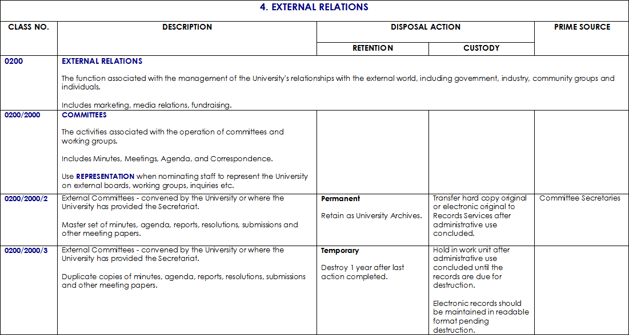
Authority Structure and Layout
Function & Scope Note
Activity & Scope Note
Notes:
If you haven’t seen the RDA before, this is an extract from it.
If you’re familiar with the Enterprise Classification Scheme (also known by its acronym ECS), you’ll see a few familiar things – function and activity scope notes.
The function is the first and highest level in the ECS. It is indicated at the top of each page in capital letters and a description is provided in its first occurrence in the RDA.
This second level in the ECS is activity. Activities are the processes or operations that are undertaken as part of each University function. The description provides some details of the transactions that take place in relation to the activity.

Slide 11
Authority Structure and Layout
Notes:
And that’s where the similarity to the ECS ends. Because this is a retention and disposal authority there is:
CLASS NUMBER - this is for citation and ease of reference purposes. The RDA is numbered so that the numbers will always stay the same; new classes will be added after the existing ones.
DESCRIPTION - of the records classes generated as a consequence of performing the business function and activity. The descriptions can refer to one record class, such as a register, or a batch of records documenting a particular set of transactions but they all require the same disposal action.
DISPOSAL ACTION is broken into two components – this details what is to happen to the records.
The RETENTION entry provides the archival status - either permanent or temporary. If the disposition is temporary, then a retention period is provided based on legal/institutional features of the record. E.g. in the example provided, the retention is Destroy 1 year after last action completed – this can mean the date a file was closed, the date a record was last referred to, the date the last entry was made or the date a record was last updated etc
CUSTODY specifies where the responsibility for care of the records lies during the different phases of their existence - it will indicate what to do with the records once they are no longer required by the work unit. For permanent records it is usually….. And for temporary records it is usually….
The PRIME SOURCE entry notes the work unit or division responsible for maintaining the Prime Source of the university record generated by the function and activity. The nominated work unit or division will retain responsibility for custody and security of the records class in accordance with legislative, financial, administrative and archival recordkeeping requirements – that is, in accordance with the RDA. In the case of Permanent Records, the work unit may transfer them to Records Services when no longer required for business purposes. Where no Prime Source is indicated, records are to be managed by the work unit currently holding custody. In the case of records with temporary retention, where the Prime Source is not your work unit, then the records are considered to be a duplicate of the Prime Source's record and can be destroyed in accordance with Normal Administrative Practice (NAP).

Slide 12
What do I do if the records I want to dispose of aren’t covered by the RDA?
Contact a Records Analyst
They will recommend either the incorporation of the records into an existing disposal class in the RDA or develop a new disposal class by writing an Appraisal Report
Either method will result in the RDA being updated
Notes:
If the records you want to dispose of aren’t covered by the RDA, then the best thing to do is to contact Carmela, Adelaide or myself – your friendly Records Analysts.
We’ll ask for some more detail about your records and see if they will fit into an existing records disposal class in the RDA. If they don’t we will develop a new records disposal class by writing an Appraisal Report. An Appraisal Report will allow the records to be sentenced (and destroyed if the sentence permits) in the interim period between RDA updates. The Appraisal Report is written in consultation with the client and is approved by the manager of the work unit that is the custodian of the records, the University Secretary and the University Archivist. Legal Services and Internal Audit may also be consulted where necessary.
Appraisal Reports written between Retention and Disposal Authority updates will be incorporated into the next update.
The RDA will also be updated on a regular basis as new record classes are identified by Records Services or when they are brought to our attention.

Slide 13
Using the RDA
Examine the records to see what they are about
Determine function & activity used to create the records – look up the ECS (http://www.unimelb.edu.au/records/ECS/)
Then refer to the RDA and the corresponding function & activity
Read through the records class under that function & activity combination
If more than one records class covers the records you have, either seek clarification with a Records Analyst or use the disposal sentence with the longest retention period
If unable to find an appropriate records class, contact a Records Analyst
Notes:
How to use it?
Examine the records to gain a better understanding as to what their contents are and what matters they concern – this may involve reading or scanning the contents of a file (both hard copy and electronic) as the file title (if there is one!) is not always an accurate reflection of a file’s contents.
Determine the function and activity that resulted in the creation of the records – use the University’s Enterprise Classification Scheme.
Once you have identified the function and activity in the ECS, then locate the corresponding function and activity within the Retention and Disposal Authority. Read through the records classes under that function and activity combination and assess which, if any, of the classes matches the records. More than one relevant records class may be identified. In these cases, records should be sentenced against the longest available retention period, taking into consideration any relevant information privacy issues.
If unable to find an appropriate records class, then contact a Records Analyst.

Slide 14
Accessing the RDA
RDA available as an online database at
http://www.unimelb.edu.au/records/RDA/
RDA available as a document
http://www.unimelb.edu.au/records/corporate/disposal.html

Slide 15
© Copyright The University of Melbourne 2011

