Slide 1
Records Management Network Meeting
8 March 2017

Slide 2
Agenda
Welcome
Kathryn Dan, Associate Director, Records & Compliance
The Faculty of VCA and MCM Southbank disposal project
Guest Speakers: Colleen Wait, EA to the Dean and Faculty Executive Director, Pina Barbieri, Project Records Officer and Alina Hamilton, Project Records Officer
The Faculty of VCA and MCM Southbank Film and Television Digital Archive Project
Guest Speaker: Donna Hensler, VCA Screen Production Coordinator
Higher Education Retention and Disposal Authority issued by Public Record Office Victoria: what are the next steps?
Lucinda Davies, Records Manager
Networking morning tea
University Contracts and Agreements
Laura Tanata, Records Officer (Contracts and Agreements)
Improved Recordkeeping Project Update
Rosemary Davies, Change Manager and Carmela Gallo, Records Analyst
Cloud services: being risk aware
Chris Stueven, Records Analyst and Imogen Telfer, Records Officer

Slide 3
Agenda
Welcome
Kathryn Dan, Associate Director, Records & Compliance
The Faculty of VCA and MCM Southbank disposal project
Guest Speakers: Colleen Wait, EA to the Dean and Faculty Executive Director, Pina Barbieri, Project Records Officer and Alina Hamilton, Project Records Officer
The Faculty of VCA and MCM Southbank Film and Television Digital Archive Project
Guest Speaker: Donna Hensler, VCA Screen Production Coordinator
Higher Education Retention and Disposal Authority issued by Public Record Office Victoria: what are the next steps?
Lucinda Davies, Records Manager
Networking morning tea
University Contracts and Agreements
Laura Tanata, Records Officer (Contracts and Agreements)
Improved Recordkeeping Project Update
Rosemary Davies, Change Manager and Carmela Gallo, Records Analyst
Cloud services: being risk aware
Chris Stueven, Records Analyst and Imogen Telfer, Records Officer

Slide 4
Agenda
Welcome
Kathryn Dan, Associate Director, Records & Compliance
The Faculty of VCA and MCM Southbank disposal project
Guest Speakers: Colleen Wait, EA to the Dean and Faculty Executive Director, Pina Barbieri, Project Records Officer and Alina Hamilton, Project Records Officer
The Faculty of VCA and MCM Southbank Film and Television Digital Archive Project
Guest Speaker: Donna Hensler, VCA Screen Production Coordinator
Higher Education Retention and Disposal Authority issued by Public Record Office Victoria: what are the next steps?
Lucinda Davies, Records Manager
Networking morning tea
University Contracts and Agreements
Laura Tanata, Records Officer (Contracts and Agreements)
Improved Recordkeeping Project Update
Rosemary Davies, Change Manager and Carmela Gallo, Records Analyst
Cloud services: being risk aware
Chris Stueven, Records Analyst and Imogen Telfer, Records Officer

Slide 5
Southbank Records Project
Colleen Wait
EA to Dean
Faculty of VCA & MCM

Slide 6
Schools in order of creation
1867 – National Gallery Art School
1972 – Directors Office and admin records begin
1974 – Music
1975 – Drama
1979 – Dance
1992 – FTV (formally Swinburne FTV School)
1995 - Production

Slide 7
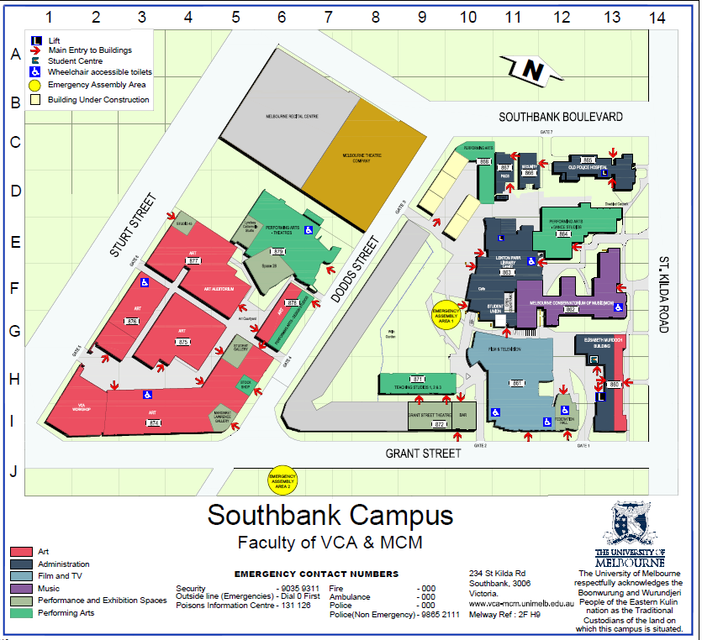

Slide 8
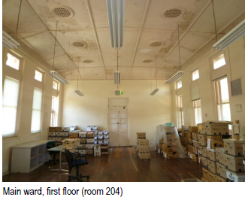

Slide 9
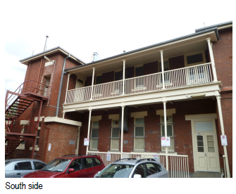

Slide 10
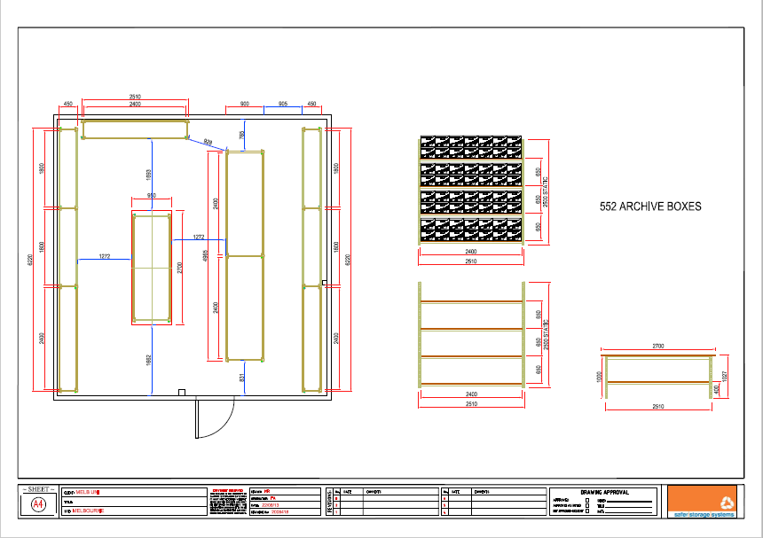

Slide 11
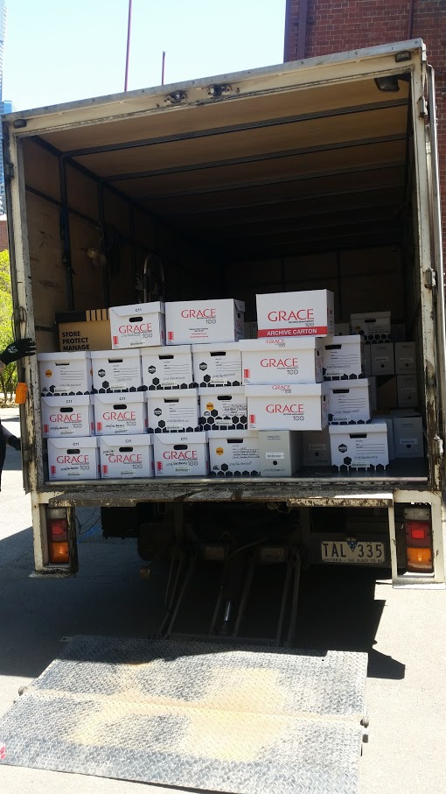

Slide 13
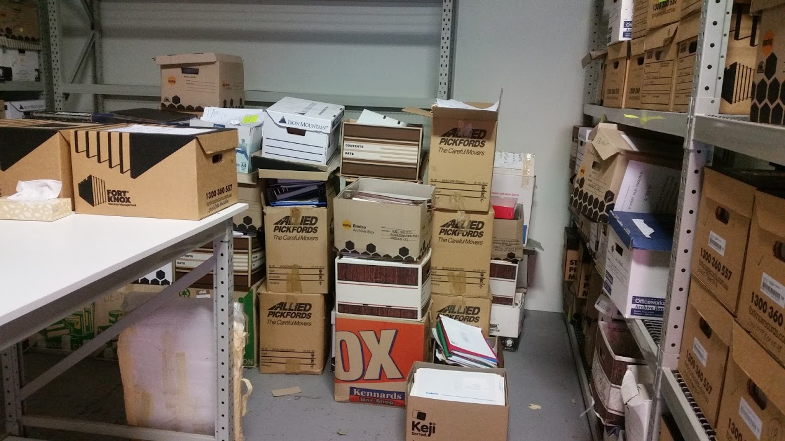

Slide 14
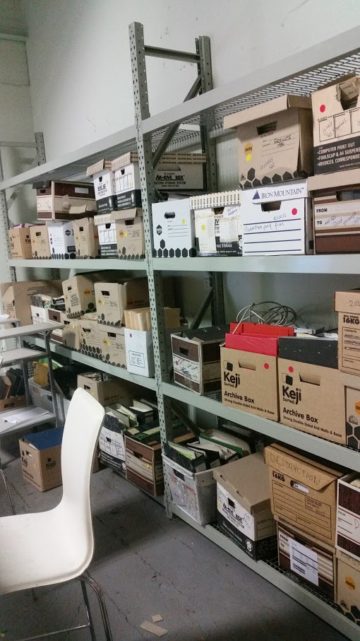

Slide 15
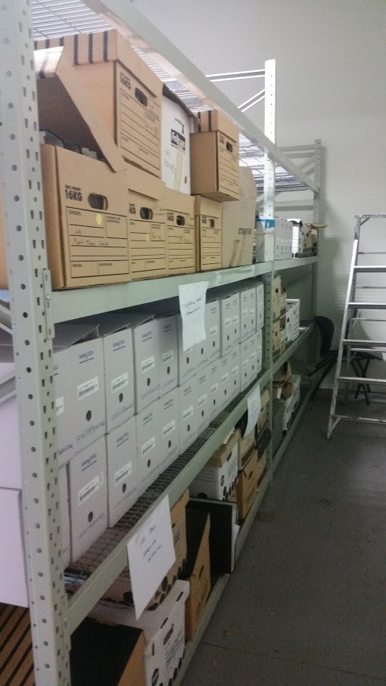

Slide 16
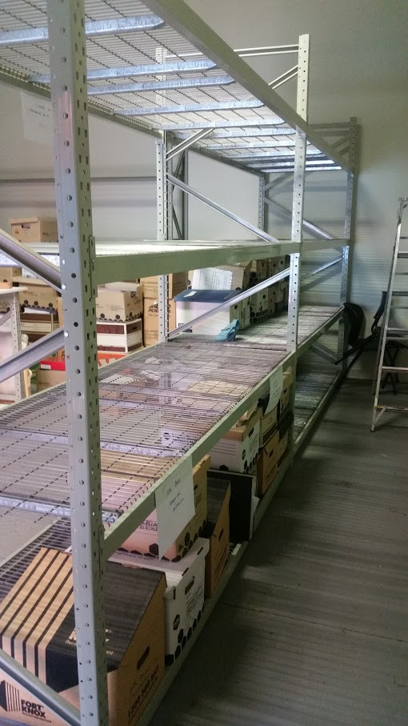

Slide 17
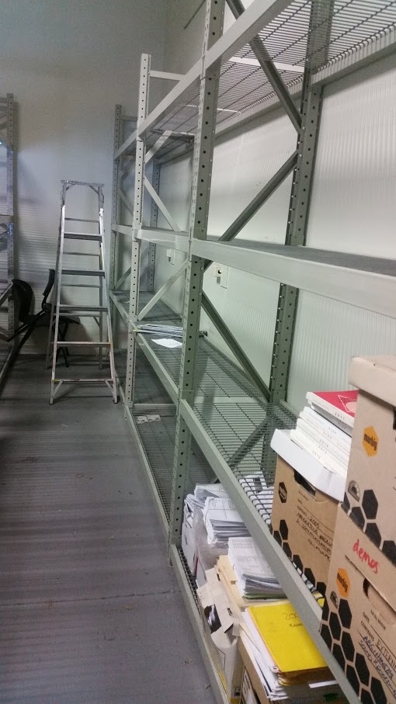

Slide 18
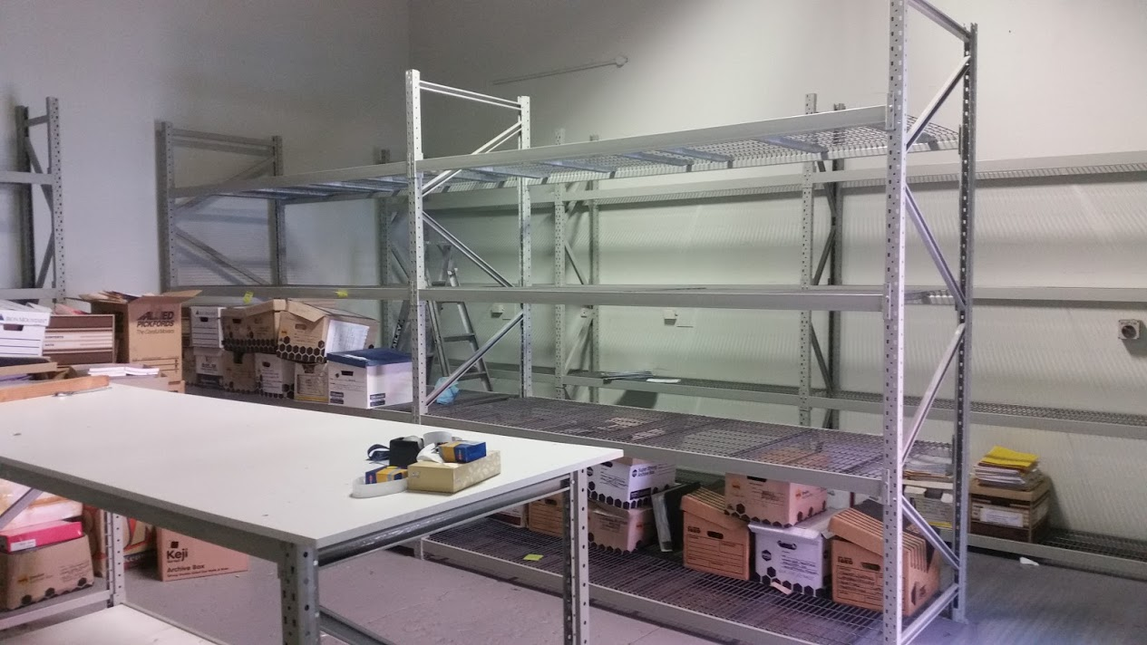

Slide 19
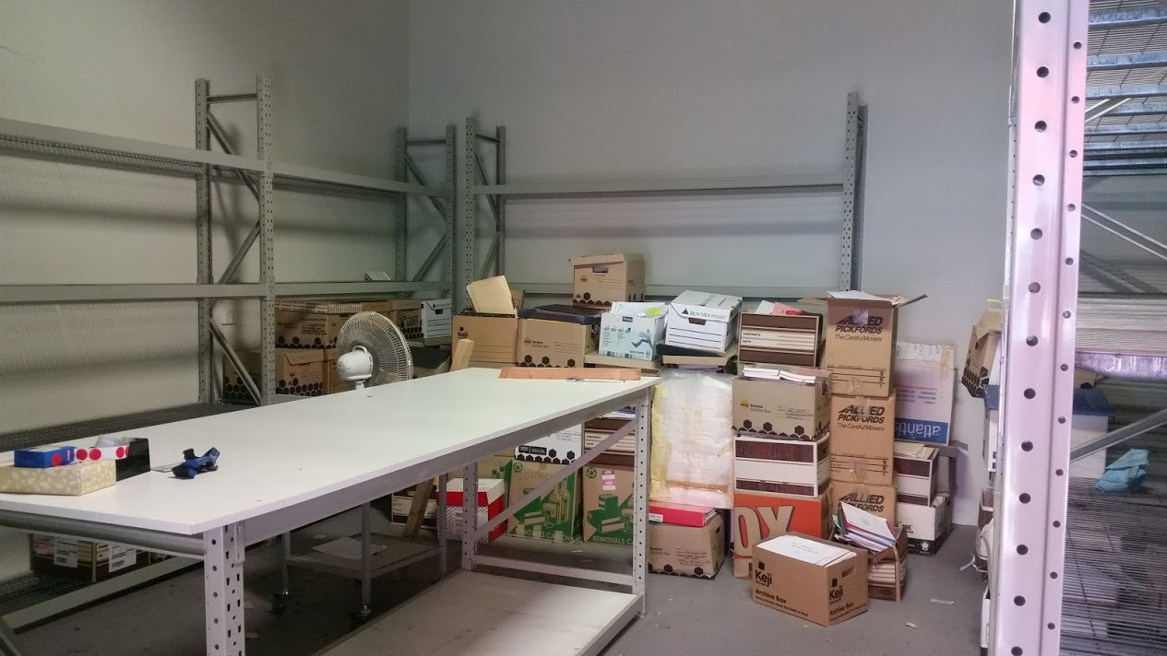

Slide 20
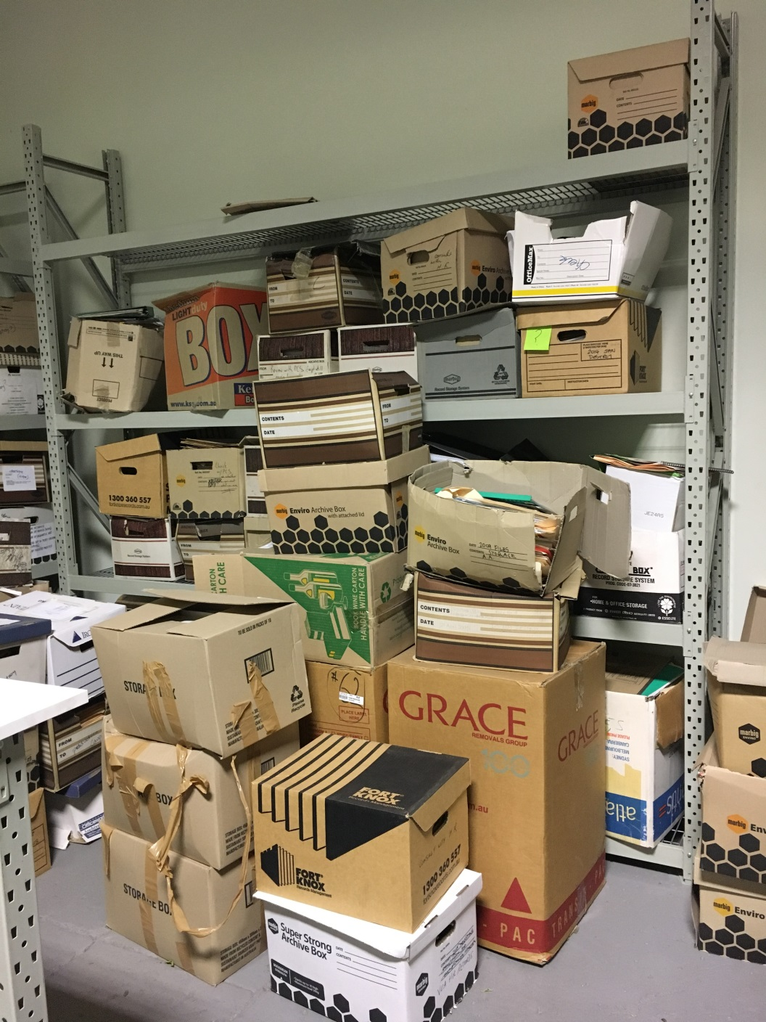

Slide 21
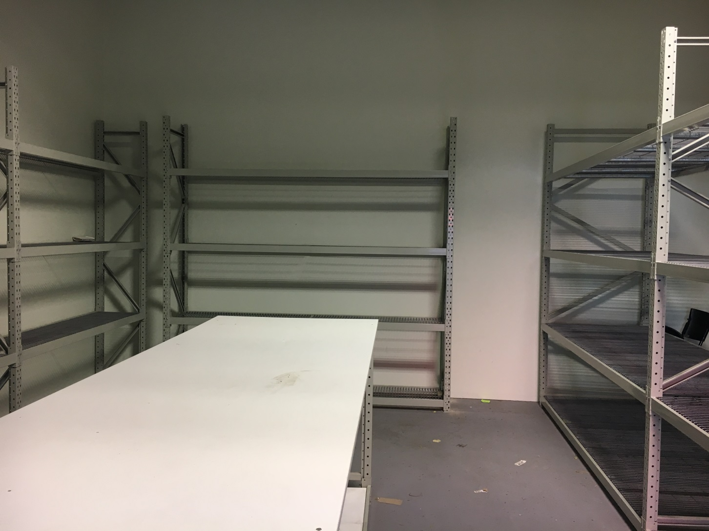

Slide 22
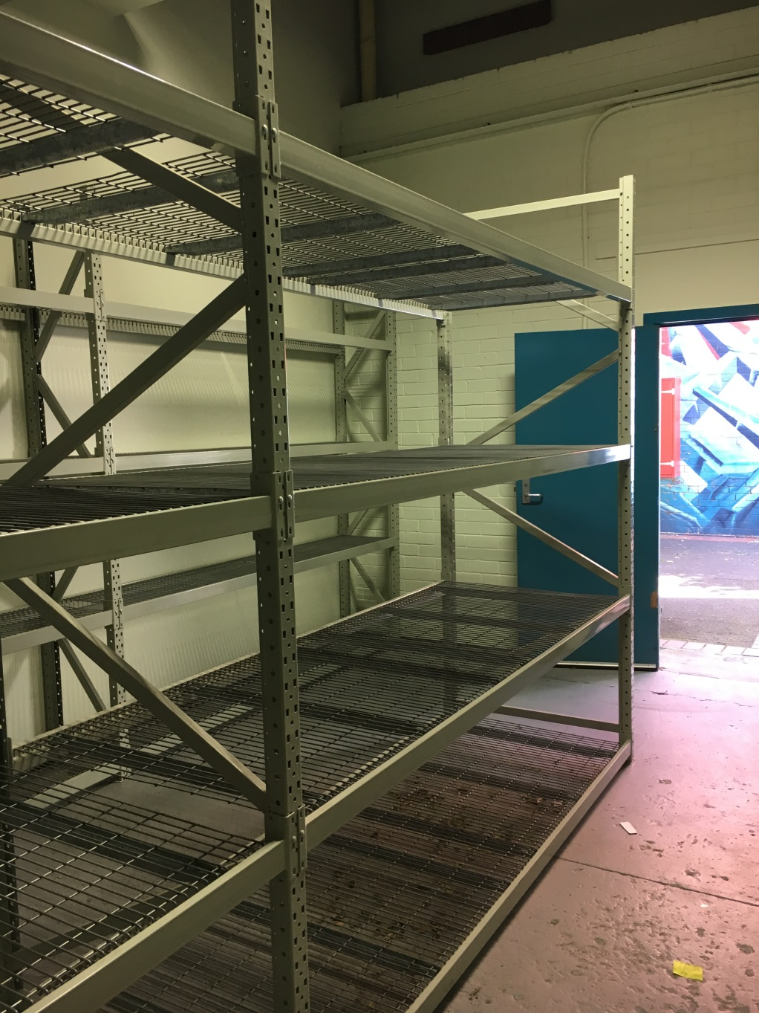

Slide 23
Agenda
Welcome
Kathryn Dan, Associate Director, Records & Compliance
The Faculty of VCA and MCM Southbank disposal project
Guest Speakers: Colleen Wait, EA to the Dean and Faculty Executive Director, Pina Barbieri, Project Records Officer and Alina Hamilton, Project Records Officer
The Faculty of VCA and MCM Southbank Film and Television Digital Archive Project
Guest Speaker: Donna Hensler, VCA Screen Production Coordinator
Higher Education Retention and Disposal Authority issued by Public Record Office Victoria: what are the next steps?
Lucinda Davies, Records Manager
Networking morning tea
University Contracts and Agreements
Laura Tanata, Records Officer (Contracts and Agreements)
Improved Recordkeeping Project Update
Rosemary Davies, Change Manager and Carmela Gallo, Records Analyst
Cloud services: being risk aware
Chris Stueven, Records Analyst and Imogen Telfer, Records Officer

Slide 24

Film and Television Digital Archive Project

Slide 25
Agenda
Welcome
Kathryn Dan, Associate Director, Records & Compliance
The Faculty of VCA and MCM Southbank disposal project
Guest Speakers: Colleen Wait, EA to the Dean and Faculty Executive Director, Pina Barbieri, Project Records Officer and Alina Hamilton, Project Records Officer
The Faculty of VCA and MCM Southbank Film and Television Digital Archive Project
Guest Speaker: Donna Hensler, VCA Screen Production Coordinator
Higher Education Retention and Disposal Authority issued by Public Record Office Victoria: what are the next steps?
Lucinda Davies, Records Manager
Networking morning tea
University Contracts and Agreements
Laura Tanata, Records Officer (Contracts and Agreements)
Improved Recordkeeping Project Update
Rosemary Davies, Change Manager and Carmela Gallo, Records Analyst
Cloud services: being risk aware
Chris Stueven, Records Analyst and Imogen Telfer, Records Officer

Slide 26
Higher and Further Education Retention and Disposal Authority issued by Public Record Office Victoria : What are the next steps?
Lucinda Davies, Records Manager

Slide 27
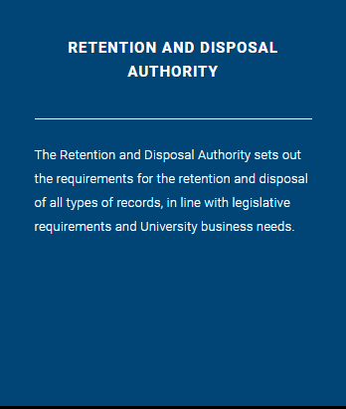
University RDA Update
The Vice Chancellor was formally notified of the new standard PROS 16/07 Higher and Further Education Institutions RDA in January.
The standard authorises the disposal of records created and held by Victorian higher and further education institutions which are subject to the Public Records Act 1973 (Vic).
University of Melbourne Records Services were involved in the formulation of the new expectations.

Slide 28

New Higher Education RDA
View PDF
View Spreadsheet

Slide 29
Changes in the Spotlight
Commercialisation
Research
Change: University records on research ethics proposals, approvals and amendments. Previously up to a 20 year retention period. These are now classified as permanent material.
Student Administration
Addition: Final version of templates to produce testamurs and transcripts to be retained permanently.
Permanent records include feasibility studies, consolidated plans and summary reports of significant consultancies.
New: An additional category of records related to the formation and management of commercial enterprises by the University.
Change: More scope for research data and outputs to be retained permanently by the university.
For example, research on gene therapy, and projects documenting the long term impact of variable on the environment or society.
New expectations on student records regarding non-award university courses. For example, the UoM Community Access Program (CAP) and Foundational Studies.

Slide 30
2017 Timeline
January
University notified of the new standard
February - March
April/May
Amended University RDA made live on the Records website and communication on staff news, yammer and other avenues.
June
The mapping of the University RDA to new expectations of PROS 16/07
Accommodate existing amendments from university business units
Records Management Network RDA Workshop

Slide 31


© Copyright The University of Melbourne 2011

Slide 32
Agenda
Welcome
Kathryn Dan, Associate Director, Records & Compliance
The Faculty of VCA and MCM Southbank disposal project
Guest Speakers: Colleen Wait, EA to the Dean and Faculty Executive Director, Pina Barbieri, Project Records Officer and Alina Hamilton, Project Records Officer
The Faculty of VCA and MCM Southbank Film and Television Digital Archive Project
Guest Speaker: Donna Hensler, VCA Screen Production Coordinator
Higher Education Retention and Disposal Authority issued by Public Record Office Victoria: what are the next steps?
Lucinda Davies, Records Manager
Networking morning tea
University Contracts and Agreements
Laura Tanata, Records Officer (Contracts and Agreements)
Improved Recordkeeping Project Update
Rosemary Davies, Change Manager and Carmela Gallo, Records Analyst
Cloud services: being risk aware
Chris Stueven, Records Analyst and Imogen Telfer, Records Officer

Slide 33
Agenda
Welcome
Kathryn Dan, Associate Director, Records & Compliance
The Faculty of VCA and MCM Southbank disposal project
Guest Speakers: Colleen Wait, EA to the Dean and Faculty Executive Director, Pina Barbieri, Project Records Officer and Alina Hamilton, Project Records Officer
The Faculty of VCA and MCM Southbank Film and Television Digital Archive Project
Guest Speaker: Donna Hensler, VCA Screen Production Coordinator
Higher Education Retention and Disposal Authority issued by Public Record Office Victoria: what are the next steps?
Lucinda Davies, Records Manager
Networking morning tea
University Contracts and Agreements
Laura Tanata, Records Officer (Contracts and Agreements)
Improved Recordkeeping Project Update
Rosemary Davies, Change Manager and Carmela Gallo, Records Analyst
Cloud services: being risk aware
Chris Stueven, Records Analyst and Imogen Telfer, Records Officer

Slide 34
Introduction to Contracts and Legal Agreements
Laura Tanata Records Officer – Contracts and Agreements

Slide 35
Introduction to Contracts and Legal Agreements
Laura Tanata
Records Officer (Contracts and Agreements)
x53747
laura.tanata@unimelb.edu.au
Records Services
x43534
records-services@unimelb.edu.au

Slide 36
Introduction to Contracts and Legal Agreements
Responsibilities within the Business Units
Most larger contracts and legal agreements are handled through Legal Services.
Keep an eye for smaller legal agreements and contracts within your business area and have them sent to Records and Compliance via internal mail.
Examples of legal documents to look for include:
Independent Contractor Agreement | One Way Confidentiality Agreement
Confidentiality Agreement | Standard Mutual Confidentiality Agreement
Artists Agreement | Deed of Consent
Acquisition of Services Agreement | Vocational Student Placement Letter Agreement
Supply of Services Agreement | Professional Placement Letter Agreement

Slide 37
Introduction to Contracts and Legal Agreements
    Understanding Contracts and Legal Agreements
    In accordance to the university Records Management Policy (MPF1106), it is expected that business units are aware of their recordkeeping duties. Extract from Policy 4.1:
    “The University creates, captures and maintains full and accurate records of its activities, including outsourced, contracted or cloud-based activities. All areas of University operations must keep records in accordance with this policy, on matters such as research, learning and teaching, engagement, administrative operations and commercial activities”
    The Contracts Policy (MPF1247) also prescribes:
    “Written records of contract negotiations must be kept in the enterprise records system”
    “All fully executed contracts must be kept in the enterprise records system…[including] capturing the records of renewals”

Slide 38


Introduction to Contracts and Legal Agreements
    As of Friday 9 March 2017, Records and Compliance will be moving to a temporary decanting space:
    Level 1, 21 Bedford Street, North Melbourne
    At this stage, we will be in the temporary space until mid 2017.

Slide 39
© Copyright The University of Melbourne 2011

Slide 40
Agenda
Welcome
Kathryn Dan, Associate Director, Records & Compliance
The Faculty of VCA and MCM Southbank disposal project
Guest Speakers: Colleen Wait, EA to the Dean and Faculty Executive Director, Pina Barbieri, Project Records Officer and Alina Hamilton, Project Records Officer
The Faculty of VCA and MCM Southbank Film and Television Digital Archive Project
Guest Speaker: Donna Hensler, VCA Screen Production Coordinator
Higher Education Retention and Disposal Authority issued by Public Record Office Victoria: what are the next steps?
Lucinda Davies, Records Manager
Networking morning tea
University Contracts and Agreements
Laura Tanata, Records Officer (Contracts and Agreements)
Improved Recordkeeping Project Update
Rosemary Davies, Change Manager and Carmela Gallo, Records Analyst
Cloud services: being risk aware
Chris Stueven, Records Analyst and Imogen Telfer, Records Officer

Slide 41
Improved Recordkeeping
Project Update

Slide 42
Introduce Project Team
Role | Name
Project Manager | Peter Duma
Trainer | Michelle Cooper
Business & Records Analysis Lead | Howard Leaney
Business & Records Analyst | Kate Riordan
Business & Records Analyst | Kim Tu Pham
Business & Records Analyst | Carmela Gallo
Change & Communications Manager | Rosemary Davies

Slide 43
Project has successfully rolled out to the following groups ….
Procurement
Audit Assurance Service
FES – Health & Safety
External Relations – Offshore Recruitment
Records & Compliance
Legal Services
Office for Research, Ethics & Integrity
External Relations – International Relations
Infrastructure – Space Management
Special Collections – Client Services
Archives
External Relations – Onshore Recruitment

Slide 44
Benefits to groups rolled out …
New Classification Naming Structure and Conventions has made managing records easier
Reporting directly from HPRM faster and simpler
Able to monitor and share key business processes more effectively, ie. linking outlook email folders to HPRM folders
Reduce the risk of accidental deletion of documents and folders from the File Share
Able to find information more easily, even material that was “lost” (hidden) rediscovered
Ability to now share documentation with agencies – previously restricted by Network access can now be facilitated through My UniApps
Improved capacity to share with other areas across the University reducing file duplications
More open records access for units across businesses has improved searching experiences

Slide 45
What’s happening over next few months
Complete rollout to MGSE
Prioritise next set of groups to be implemented
Develop a “Service Operating Model” to sustain the change to rolled out groups
Undertaking Proof Of Concept analysis to determine a solution to manage information effectively at the front end and integrate with HPRM at the back end

Slide 46
Please START preparing your group for this project by:
Stop | Start | Why
Stop saving documents to your: Local drive USB Desktop | Start saving new documents to File Share and Start moving existing frequently used key working documents to File Share | So everyone can find them Is a safer and secure location Reduces risk and liability to the University and protects you
Stop sharing documents with external people via devices such as “Drop Box” | Start sharing documents with external people via the cloud system “Cloudstor” | Is a safer and secure location The University of Melbourne preferred device Reduces risk and liability to the University and protects you
Stop locking down access when creating new documents unless private & confidential | Start creating new documents with open access unless private & confidential | So everyone can find them Reduces risk and liability to the University and protects you
Stop attaching documents to emails unless recipient doesn’t have access to document | Start linking documents to emails unless recipient doesn’t have access to document | Be able to find one version / source of truth document Reduces risk and liability to the University and protects you
Stop password protecting documents | Start saving private & confidential documents to existing restricted access folders in File Share | Cannot upload to HPRM No one has access if you are away Reduces risk and liability to the University and protects you

Slide 47
Register Expression of Interest
If you would like to:
register your expression of interest to participate in this project or
you have any questions about this presentation
please do not hesitate to contact; Rosemary Davies, the Change & Communications Manager.
A follow-up email will be sent to you with:
more information related to this presentation and
contact numbers if you should need them.

Slide 48
Agenda
Welcome
Kathryn Dan, Associate Director, Records & Compliance
The Faculty of VCA and MCM Southbank disposal project
Guest Speakers: Colleen Wait, EA to the Dean and Faculty Executive Director, Pina Barbieri, Project Records Officer and Alina Hamilton, Project Records Officer
The Faculty of VCA and MCM Southbank Film and Television Digital Archive Project
Guest Speaker: Donna Hensler, VCA Screen Production Coordinator
Higher Education Retention and Disposal Authority issued by Public Record Office Victoria: what are the next steps?
Lucinda Davies, Records Manager
Networking morning tea
University Contracts and Agreements
Laura Tanata, Records Officer (Contracts and Agreements)
Improved Recordkeeping Project Update
Rosemary Davies, Change Manager and Carmela Gallo, Records Analyst
Cloud services: being risk aware
Chris Stueven, Records Analyst and Imogen Telfer, Records Officer

Slide 49
Cloud services: being risk aware
Imogen Telfer, Records Officer and Chris Stueven, Records Analyst

Slide 50

What are cloud services?
The National Institute of Standards and Technology (NIST), a United States Department of Commerce agency, defines cloud computing as:
“a model for enabling ubiquitous, convenient, on-demand network access to a shared pool of configurable computing resources (e.g., networks, servers, storage, applications and services) that can be rapidly provisioned and released with minimal management effort or service provider interaction”.
Characteristics:
  On-demand self-service
  Broad network access
  Resource pooling
  Rapid elasticity
  Measured service
Notes:
People who think cloud storage is located in the clouds have their heads in the clouds.
Appeal of cloud services…
These descriptions are lovely but the important characteristic that often gets forgotten is that things stored in the cloud aren’t actually floating somewhere above us, but are located on servers that have a very physical location, often more than one.
Risks…

Slide 51



Who are cloud services?
Common Providers
  Office365: File Storage/Application Suite (Aus)
  Google Suite: File Storage/Application Suite (Americas, Asia & Europe)
  Dropbox: File Storage (US)
  Cloudstor: File Storage (Aus)
  Basecamp: File Storage/Project Management (US)
  Slack: File Storage/Project Management (US)
  Eventbrite: Ticketing Management (US)
  Trybooking: Ticketing Management (Aus)
  Survey Monkey: Forms/Data Analysis (US)
  Formstack: Forms (Various unidentified)
  …and many more!
Notes:
When you think of cloud services, you often tend to think of cloud storage, such as Dropbox or Google Docs. The reality is that there are many different platforms allowing people to do many different things.
For instance…
Note only 3 of these have server locations in Aus.

Slide 52
Privacy risks
The university has obligations under the Privacy and Data Protection Act 2014 (Vic)
Key warning flags:
  Information travelling out of Victoria must have reciprocal privacy protection
    Where is the cloud server physically located?
  Data security must be ensured by protecting it from misuse, loss, unauthorised access, modification and disclosure.
    Are there sufficient access restrictions and security controls?
Notes:
Eg. US Patriot Act
Eg. providers like Dropbox are only as secure as the least secure email account used to sign up.
Almost 10% of privacy enquiries related to cloud service providers currently. We can only expect that these enquiries will increase as there is more awareness.

Slide 53
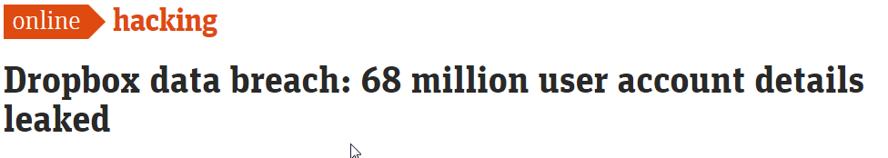
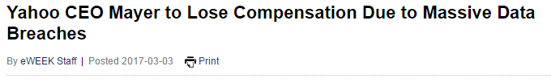

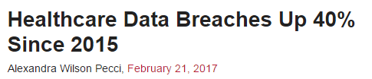
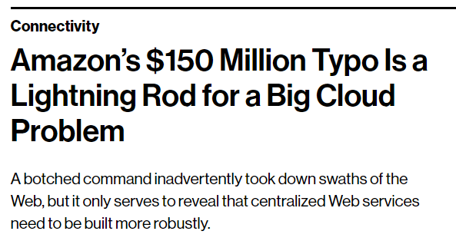

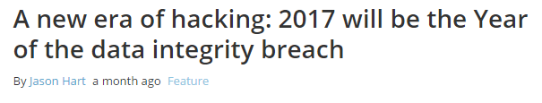
Recordkeeping risks

Slide 54

Cloud Service Risks
Possible risk of data loss
Identity theft
IT Security breach
The unintentional disclosure of personal information

Slide 55
Be aware of your information
Classification | Definition
Restricted | Information that is extremely sensitive, of great value to the University and intended for use only by various named individuals, including any personally identifiable information or credit card data
Confidential | Information assets intended strictly for distribution/use by a small selected group
Internal | University information intended only for all employees and approved non-employees such as contractors, vendors or students
Public | Information available to the general public and intended for distribution outside the University
Information Security Policy (MPF1270)

Slide 56
Simple Tips for Best Practice Use
Do not use your University of Melbourne password credentials.
Use Two-factor Authentication.
Use complex and unique password combinations.
Minimise synchronization with other cloud storage services.
Remove old devices that may be linked to the service.
Export key records for ongoing retention and delete cloud stored information
Apply a clear structure to your information
(e.g. University Enterprise Classification Scheme)

Slide 57



Preferred Services
  Australia's Academic and Research Network.
  Cloudstor File Storage
    Hosted by Faster upload speeds than a USB storage device.
    Functions similar to Dropbox
    Basic storage allowance 100GB. Additional storage upon request.
  Services with Servers located in Australia
  Office 365
  Trybooking: Ticketing Management

Slide 58
© Copyright The University of Melbourne 2011

